Slide 1

COMPUTER NETWORKS
(BCSC 0008)
Copyright content, use only with the written permission of presenter mentioned
Transport Layer

Slide 2
Text and Reference Books
Text Books:
Fourouzan B. A. (2004), “Data Communication and Networking”, 4th Edition, McGraw-Hill.
References:
Kurose, J. F. and Ross K. W. (2005), “Computer Networking: A Top-Down Approach Featuring the Internet”, 3rd Edition, Addison-Wesley.
A. S. Tanenbaum (2006), “Computer Networks”, 2nd Edition, Prentice Hall India.

Slide 3
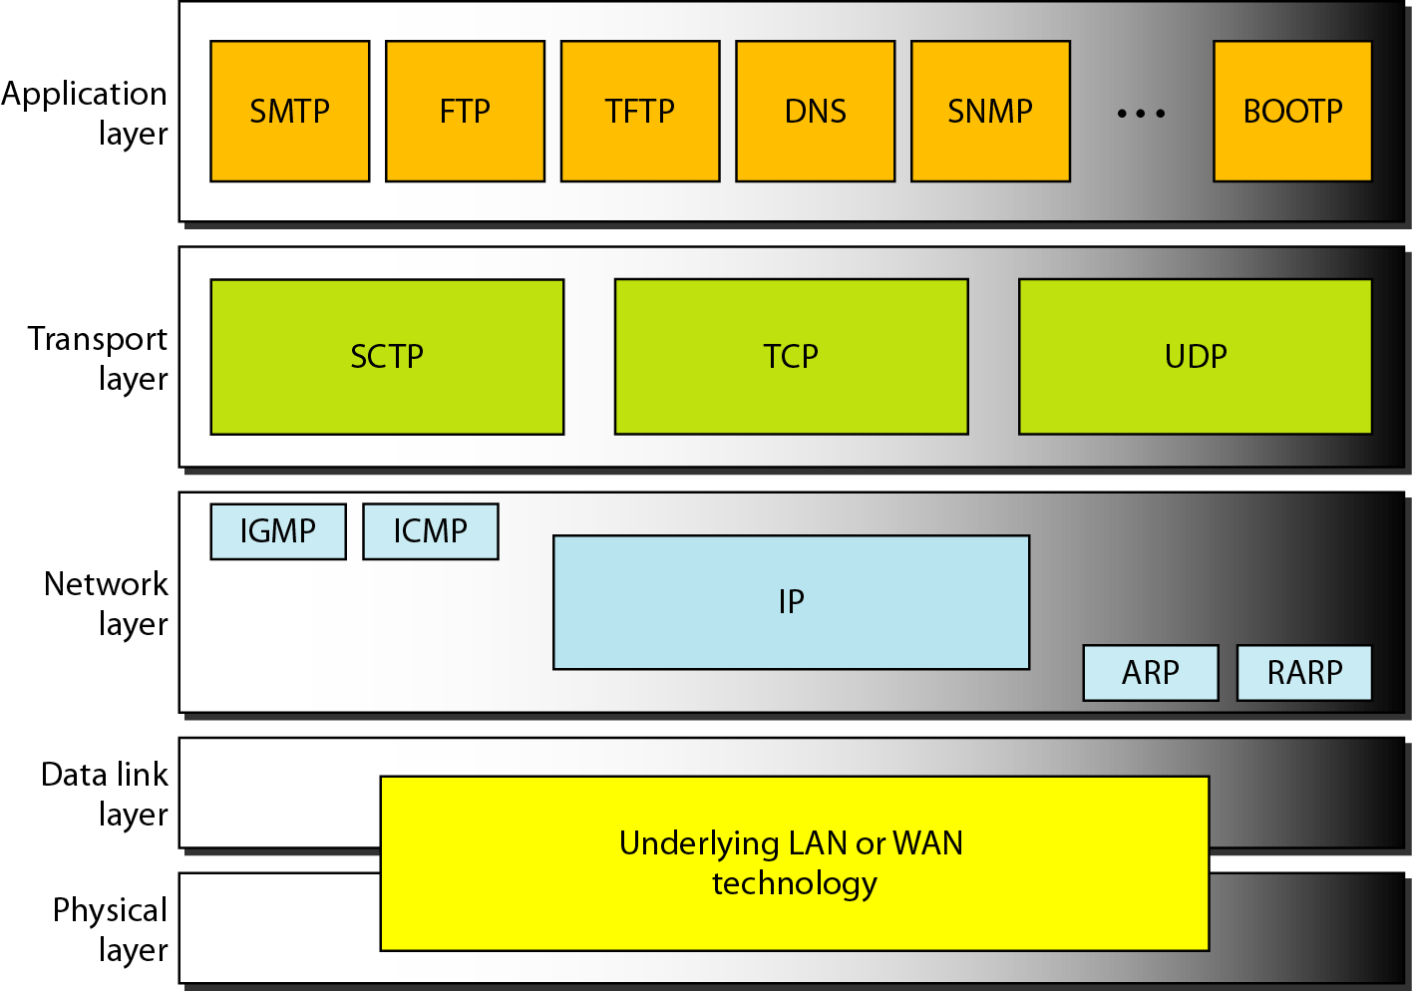
Transport Layer: Introduction
23.3
Notes:
3

Slide 4
Why we need transport layer?
Network layer is responsible for end to end (Host to Host) communication (IP address).
There are several network application running in OS.
How did NIC knows which packet belongs to which process/application?

Slide 5
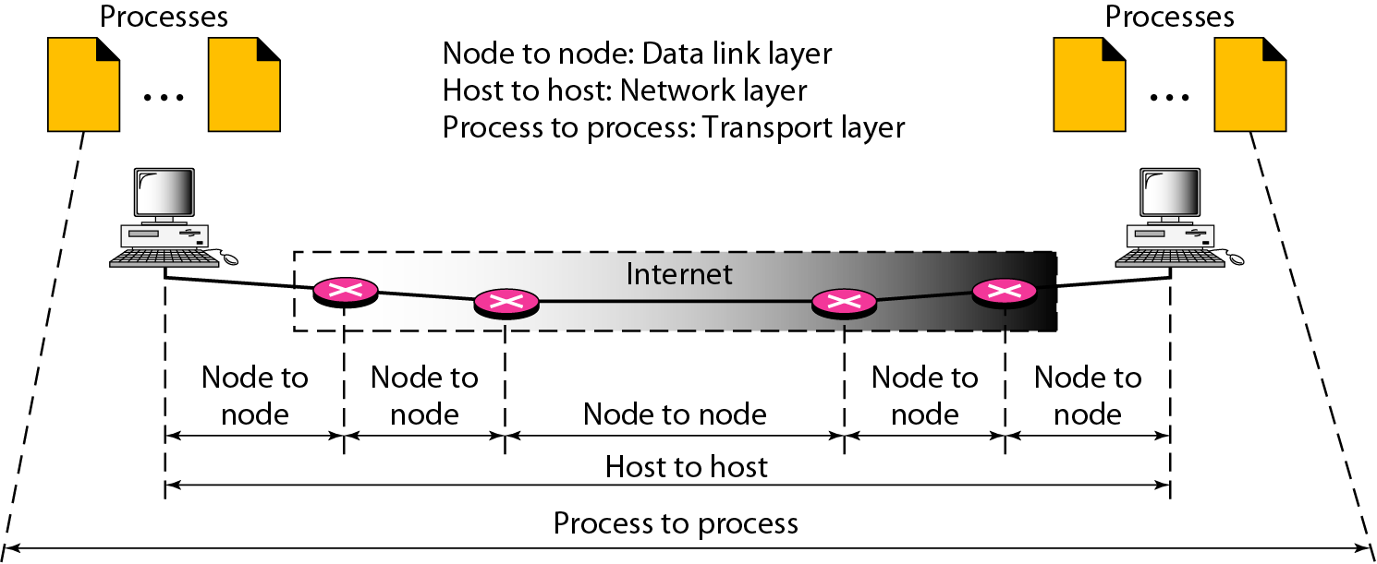
Types of data deliveries: Internet Stack

Slide 6
Continued..
The transport layer is responsible for process-to-process delivery—the delivery of a packet, part of a message, from one process to another.
It provides logical communication between app processes running on different hosts
transport protocols run in end systems
  send side: breaks app messages into segments, passes to network layer
  rcv side: reassembles segments into messages, passes to app layer
more than one transport protocol available to apps
  Internet: TCP and UDP

Slide 7
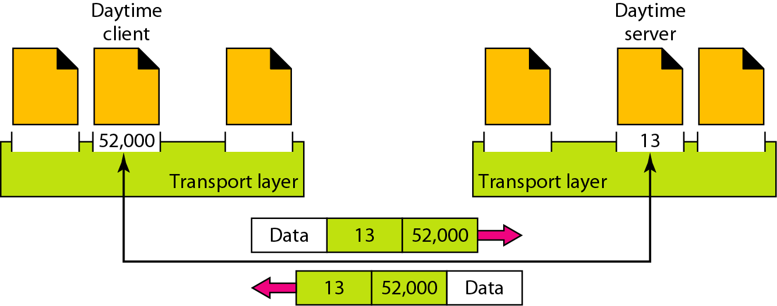
How It delivers messages to specific process
Using Port address (16 bit)
Ranges from 0 to 65,535

Slide 8
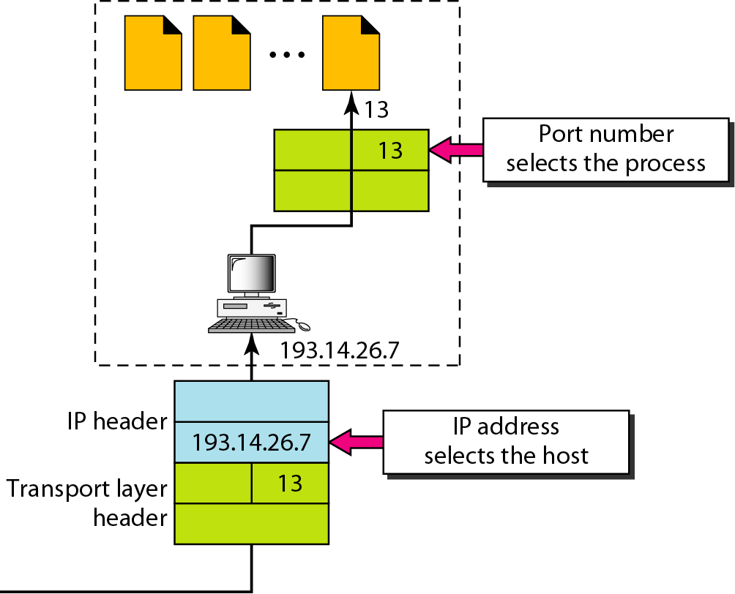
IP addresses versus port numbers
23.8
Notes:
8

Slide 9
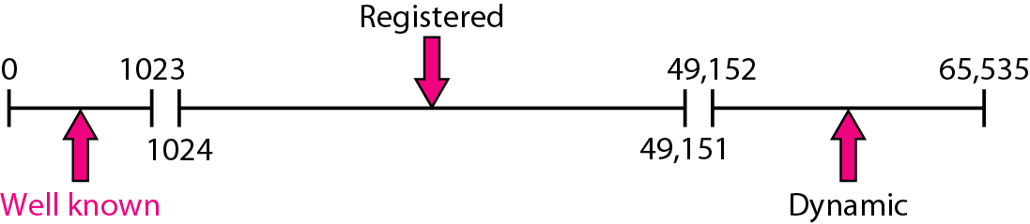
IANA ranges
23.9
Notes:
9

Slide 10
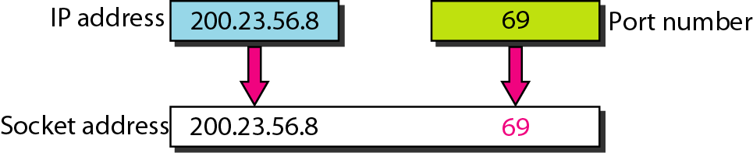
Socket address (IP address + Port Address)
What is the use of socket?
  The socket mechanism provides a means of inter-process communication (IPC).
  Socket is basically an API for enabling communication between two end points.
  A socket is one endpoint of a two way communication link between two programs running on the network.
23.10
Notes:
10

Slide 11
Socket API
application
application
application
P4
P1
P2
P3
P1
P2
transport
transport
transport
network
network
network
link
link
link
physical
physical
physical
host 1
host 2
host 3
= socket
= process

Slide 12
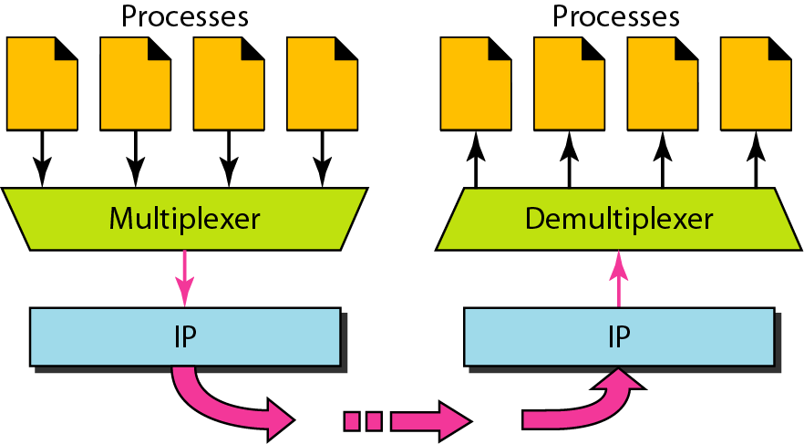
Multiplexing and demultiplexing
23.12
Notes:
12

Slide 13
Multiplexing/demultiplexing
Demultiplexing at rcv host:
Multiplexing at send host:
delivering received segments
to correct socket
gathering data from multiple
sockets, enveloping data with
header (later used for
demultiplexing)
= socket
= process
application
application
application
P4
P3
P1
P2
P1
transport
transport
transport
network
network
network
link
link
link
physical
physical
physical
host 1
host 2
host 3
13

Slide 14
Transport Layer Protocols (UDP and TCP)
UDP provides
  best effort delivery
  Connectionless
  Unreliable
  Out of order delivery
TCP
  Reliable
  In-order delivery
  Congestion control
  Flow control
  Connection setup

Slide 15
USER DATAGRAM PROTOCOL (UDP)
The User Datagram Protocol (UDP) is called a connectionless, unreliable transport protocol. It does not add anything to the services of IP except to provide process-to-process communication instead of host-to-host communication.
23.15
Notes:
15

Slide 16
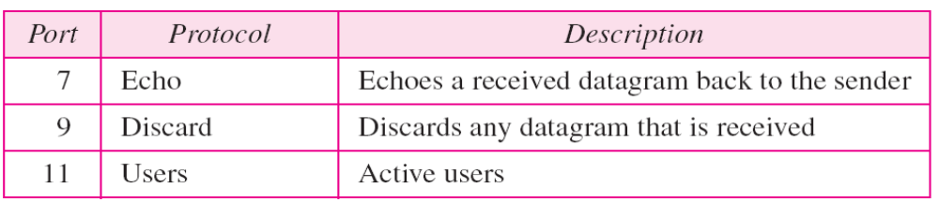
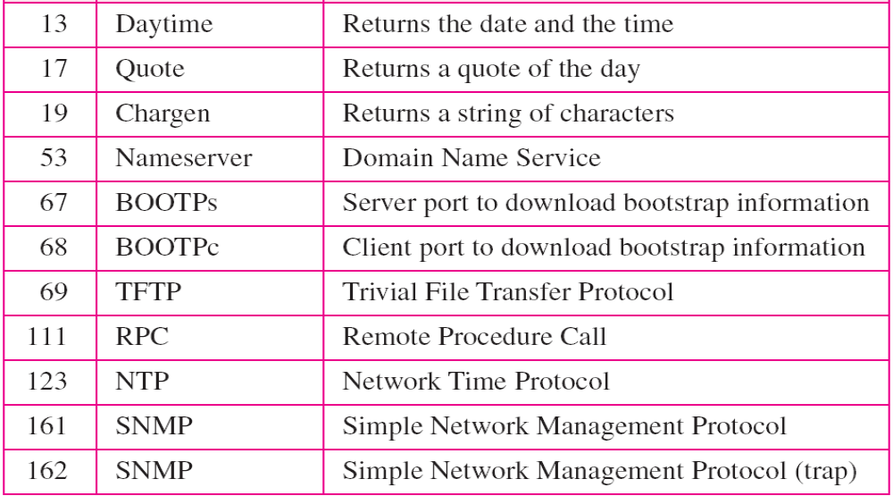
Well-known ports used with UDP
23.16
Notes:
16

Slide 17
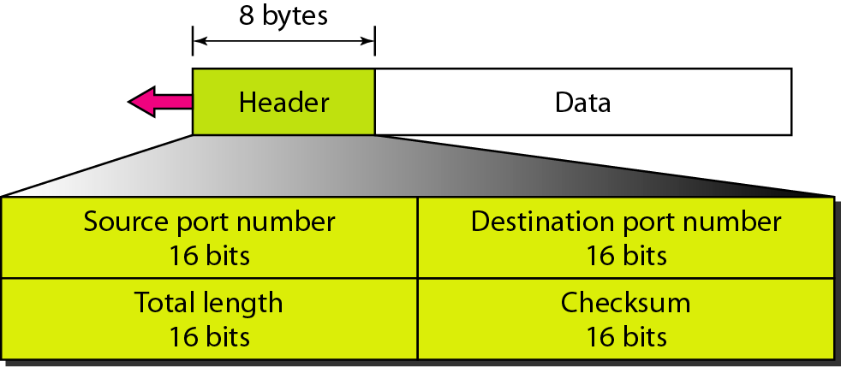
User datagram format
23.17
Notes:
17

Slide 18
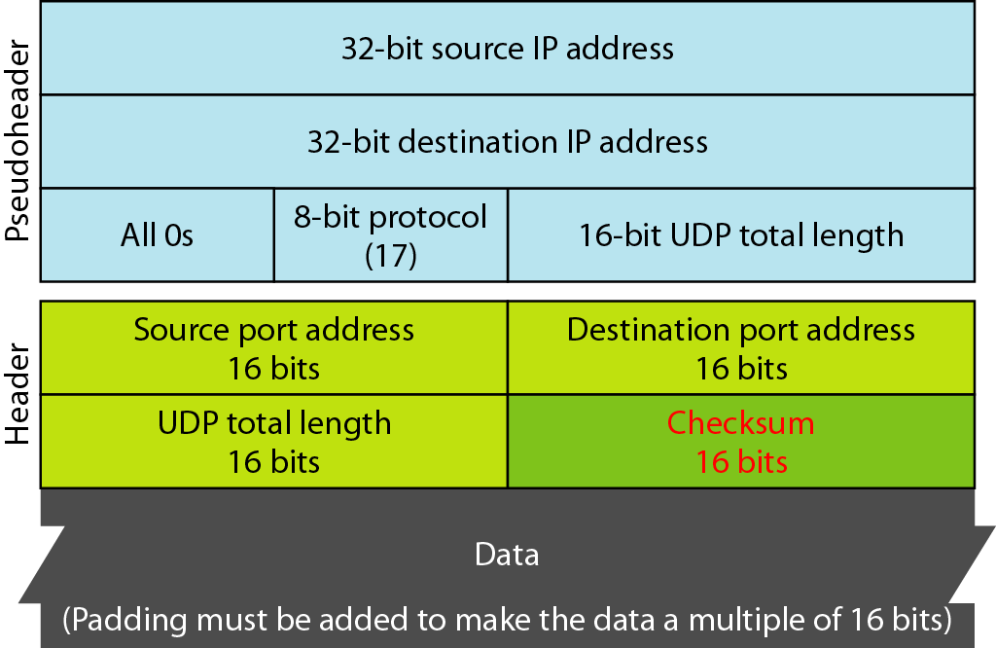
Pseudoheader for checksum calculation
23.18
Notes:
18

Slide 19
TCP
TCP is a connection-oriented protocol; it creates a virtual connection between two TCPs to send data. In addition, TCP uses flow and error control mechanisms at the transport level.
23.19
Notes:
19

Slide 20
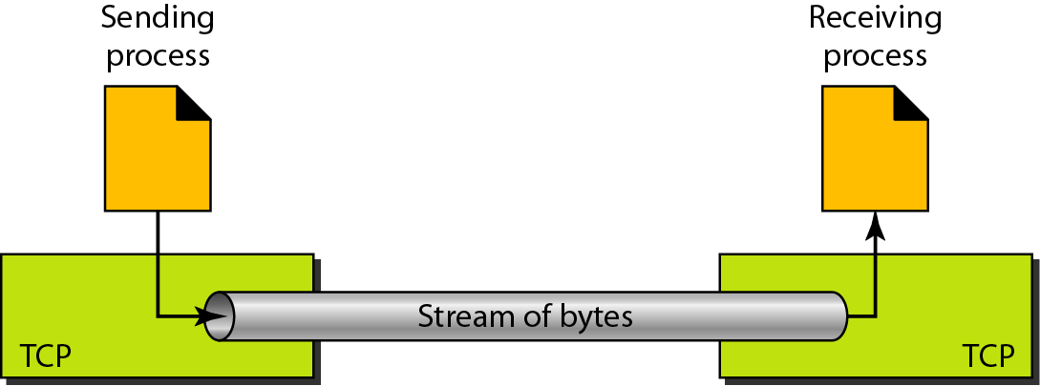
Stream delivery
23.20
Notes:
20

Slide 21
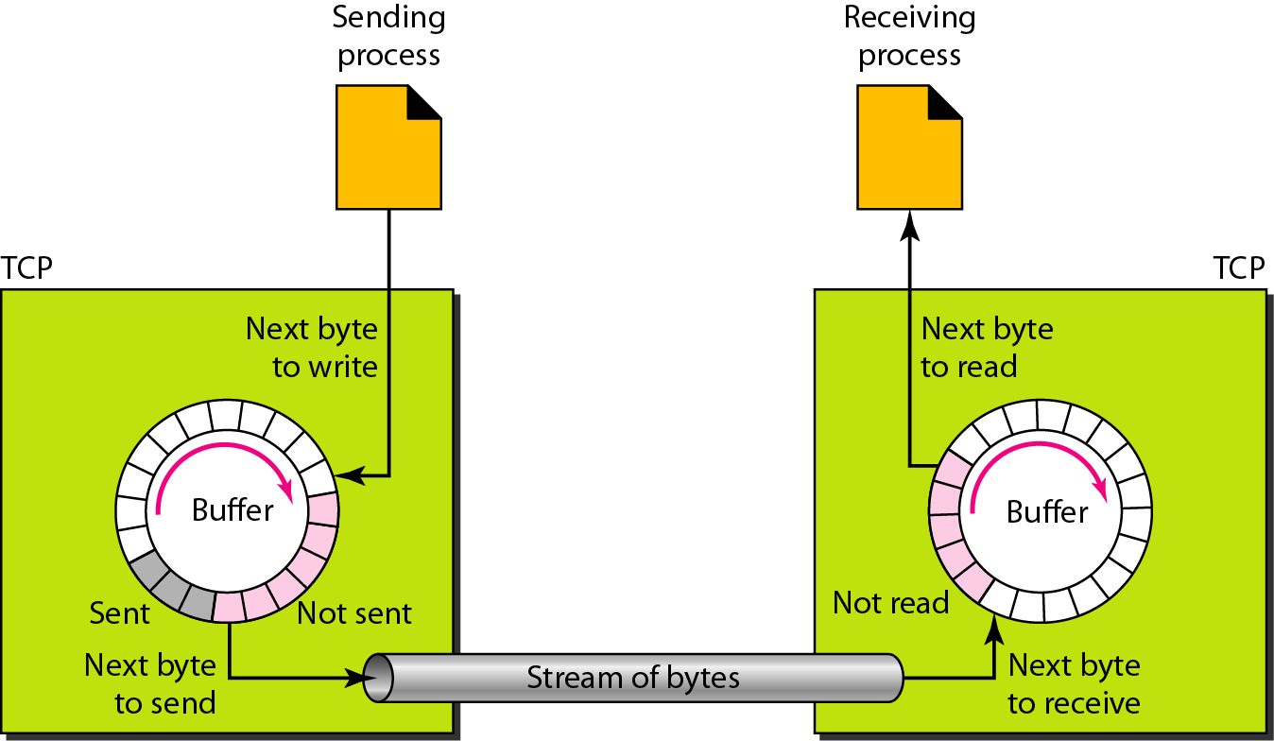
Figure Sending and receiving buffers
23.21
Notes:
21

Slide 22
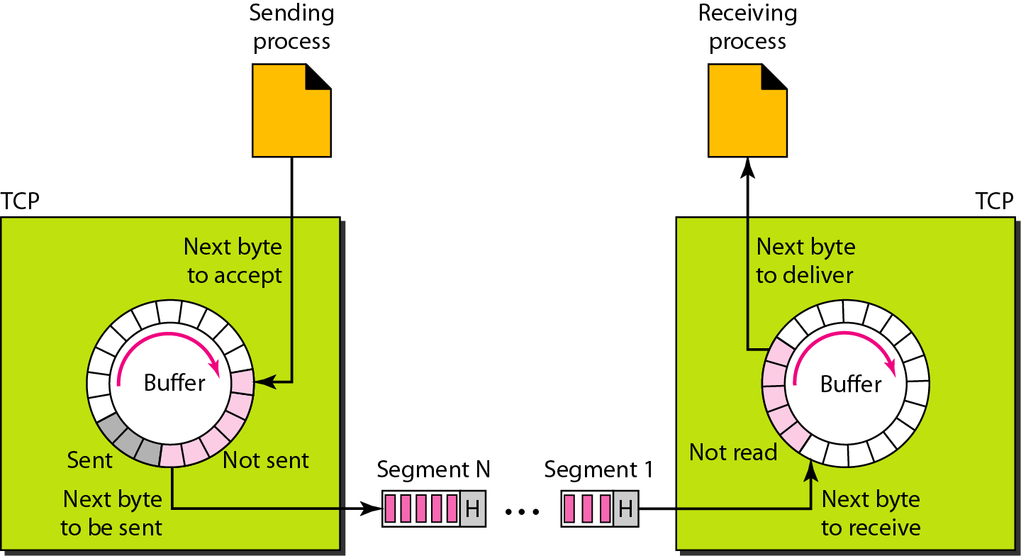
TCP segments
23.22
Notes:
22

Slide 23

Note
The bytes of data being transferred in each connection are numbered by TCP.
The numbering starts with an arbitrarily generated number. Uses 32 bits.
TCP/IP Protocol Suite
23
Notes:
23

Slide 24
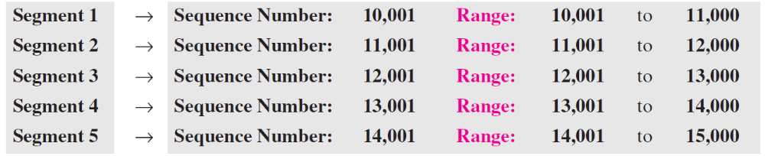
Example 15.1
Suppose a TCP connection is transferring a file of 5,000 bytes. The first byte is numbered 10,001. What are the sequence numbers for each segment if data are sent in five segments, each carrying 1,000 bytes?
Solution
The following shows the sequence number for each segment:
TCP/IP Protocol Suite
24
Notes:
24

Slide 25
Note
The value in the sequence number
field of a segment defines the number assigned to the first data byte
contained in that segment.
TCP/IP Protocol Suite
25
Notes:
25

Slide 26
Note
The value of the acknowledgment field in a segment defines the number of the next byte a party expects to receive.
The acknowledgment number is cumulative.
TCP/IP Protocol Suite
26
Notes:
26

Slide 27
SEGMENT
Before discussing TCP in more detail, let us discuss the TCP packets themselves. A packet in TCP is called a segment.
TCP/IP Protocol Suite
27
Notes:
27

Slide 28
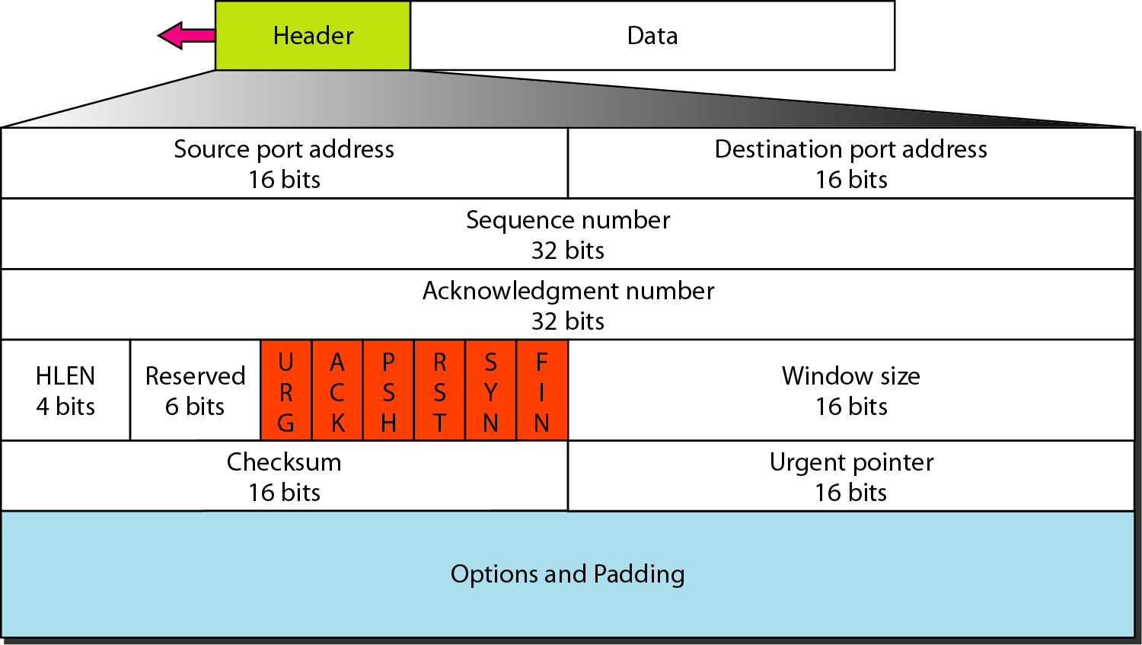
TCP segment format
23.28
Notes:
28

Slide 29
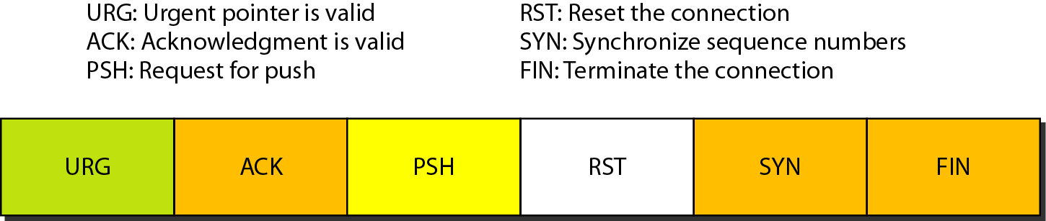
Control field
23.29
Notes:
29

Slide 30
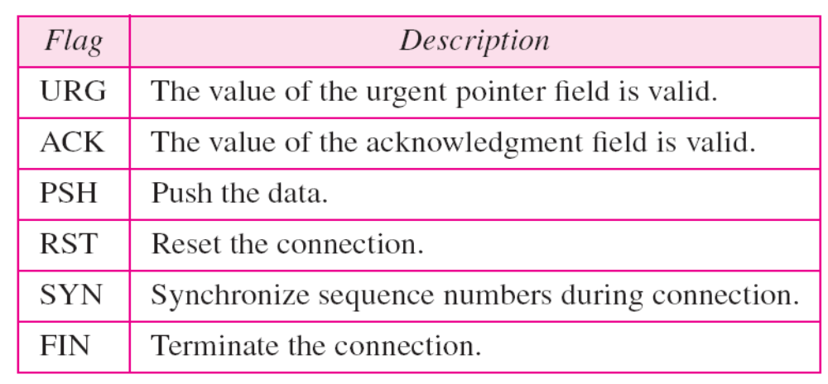
Description of flags in the control field
23.30
Notes:
30

Slide 31
A TCP CONNECTION
TCP is connection-oriented.
It establishes a virtual path between the source and destination.
All of the segments belonging to a message are then sent over this virtual path.
You may wonder how TCP, which uses the services of IP, a connectionless protocol, can be connection-oriented.
The point is that a TCP connection is virtual, not physical.
TCP operates at a higher level.
TCP uses the services of IP to deliver individual segments to the receiver, but it controls the connection itself. If a segment is lost or corrupted, it is retransmitted.
TCP/IP Protocol Suite
31
Notes:
31

Slide 32
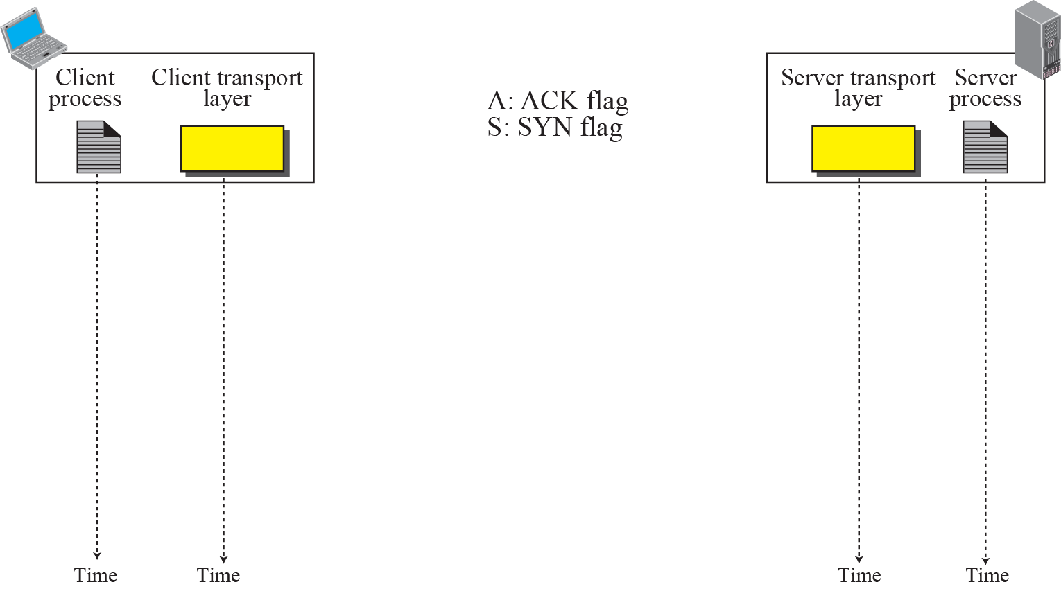

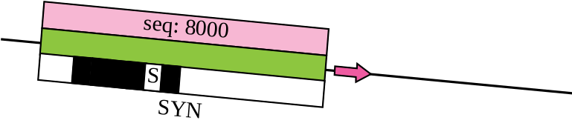

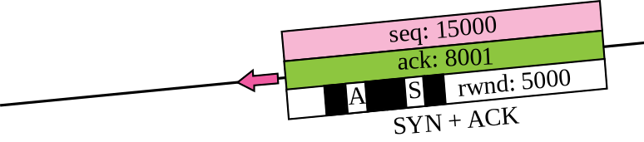

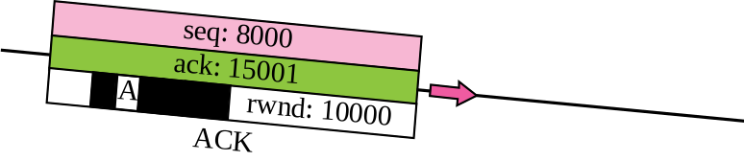

Connection establishment using three-way handshake
Means “no data” !
seq: 8001 if piggybacking
TCP/IP Protocol Suite
32
Notes:
32

Slide 33
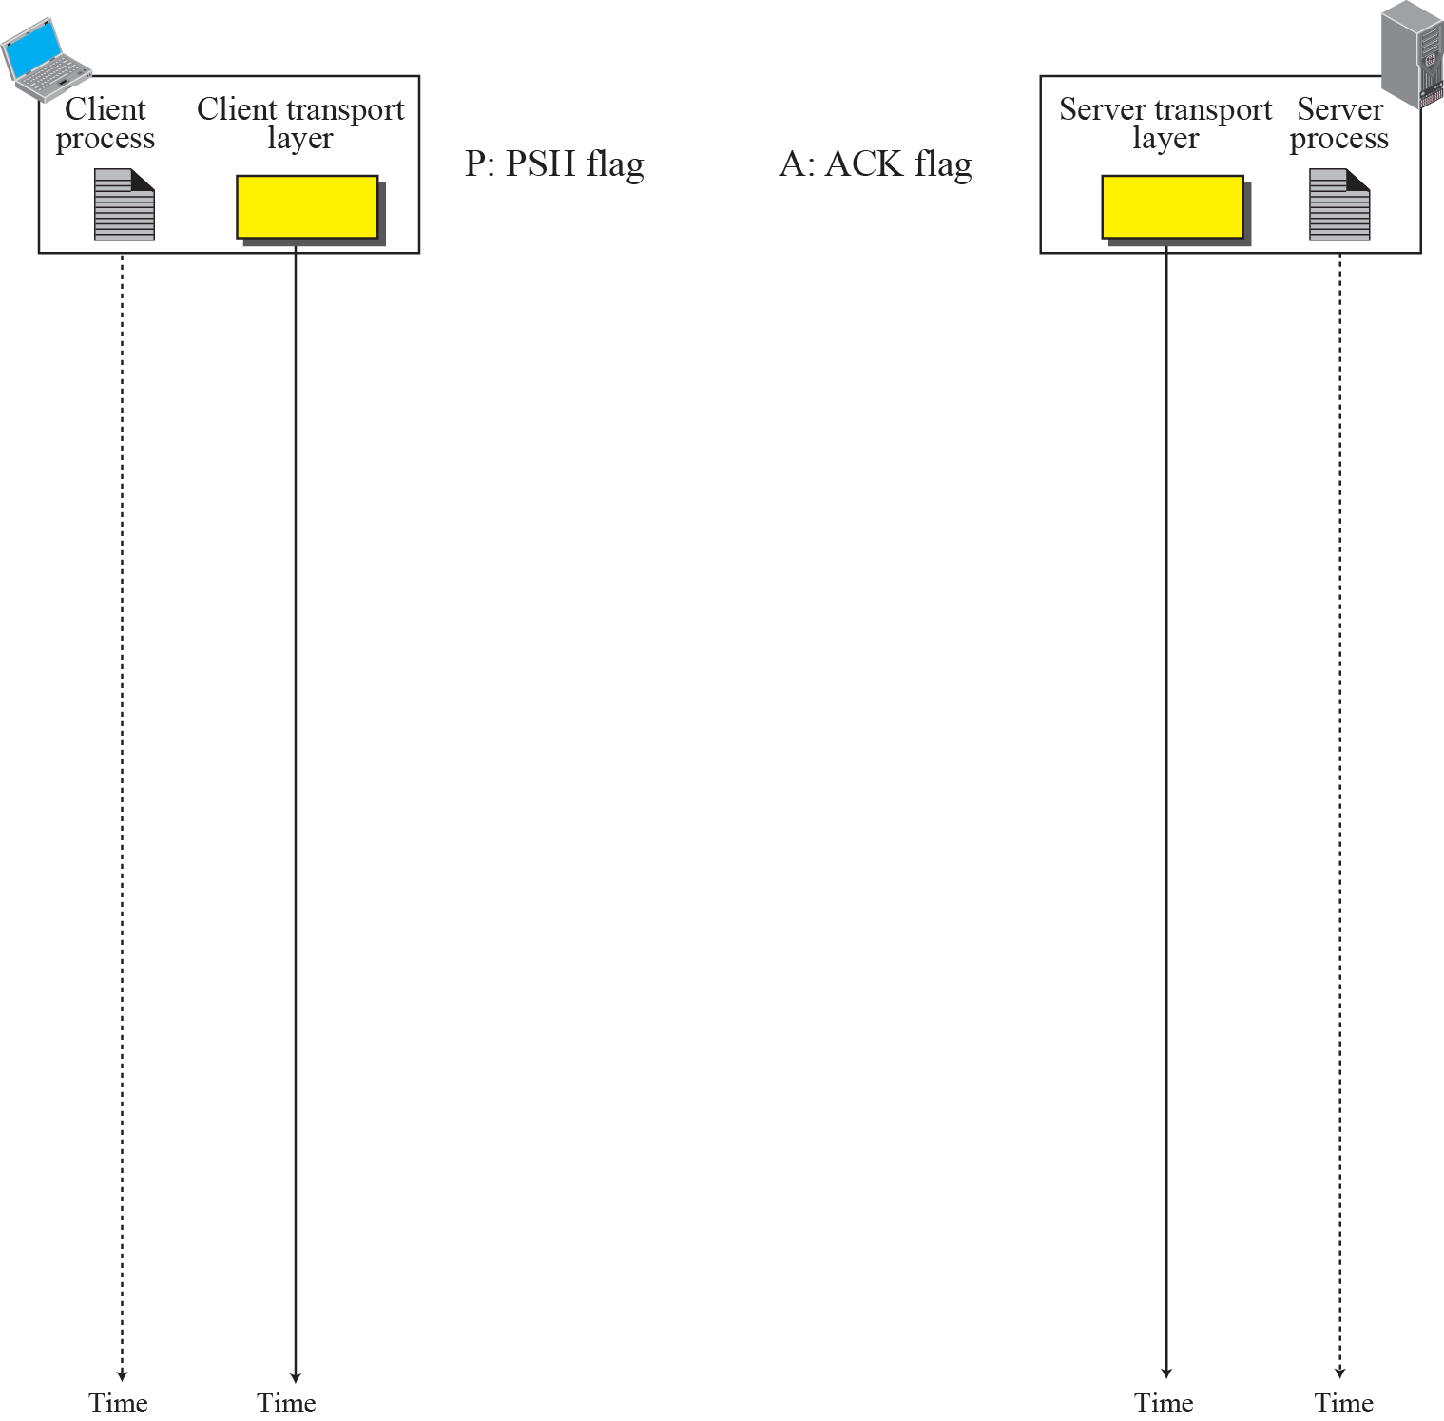
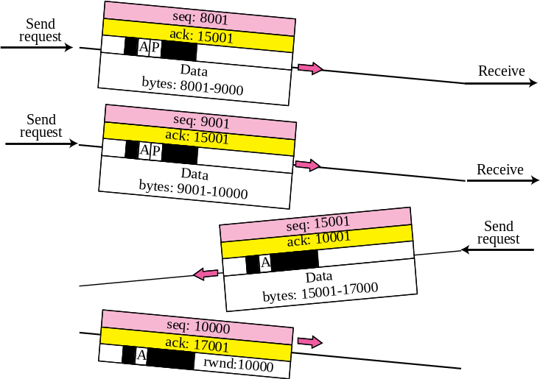

Data Transfer
Pushing data
Urgent data
TCP/IP Protocol Suite
33
Notes:
33

Slide 34
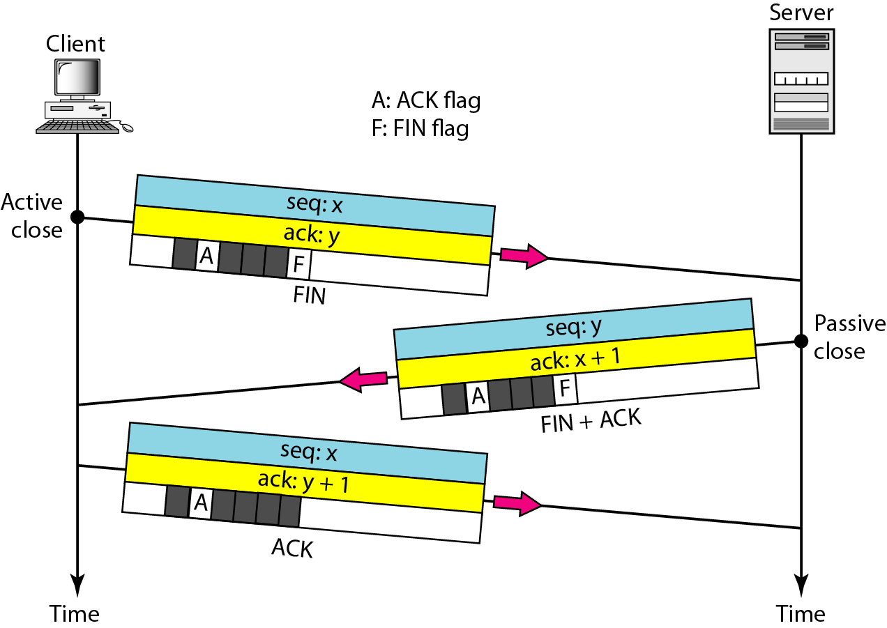
Connection termination using three-way handshaking
23.34
Notes:
34

Slide 35
TCP Window Management
Before discussing data transfer in TCP and the issues such as flow, error, and congestion control, we describe the windows used in TCP.
TCP uses two windows (send window and receive window) for each direction of data transfer, which means four windows for a bidirectional communication.
To make the discussion simple, we make an assumption that communication is only unidirectional;
The bidirectional communication can be inferred using two unidirectional communications with piggybacking.
TCP/IP Protocol Suite
35
Notes:
35

Slide 36
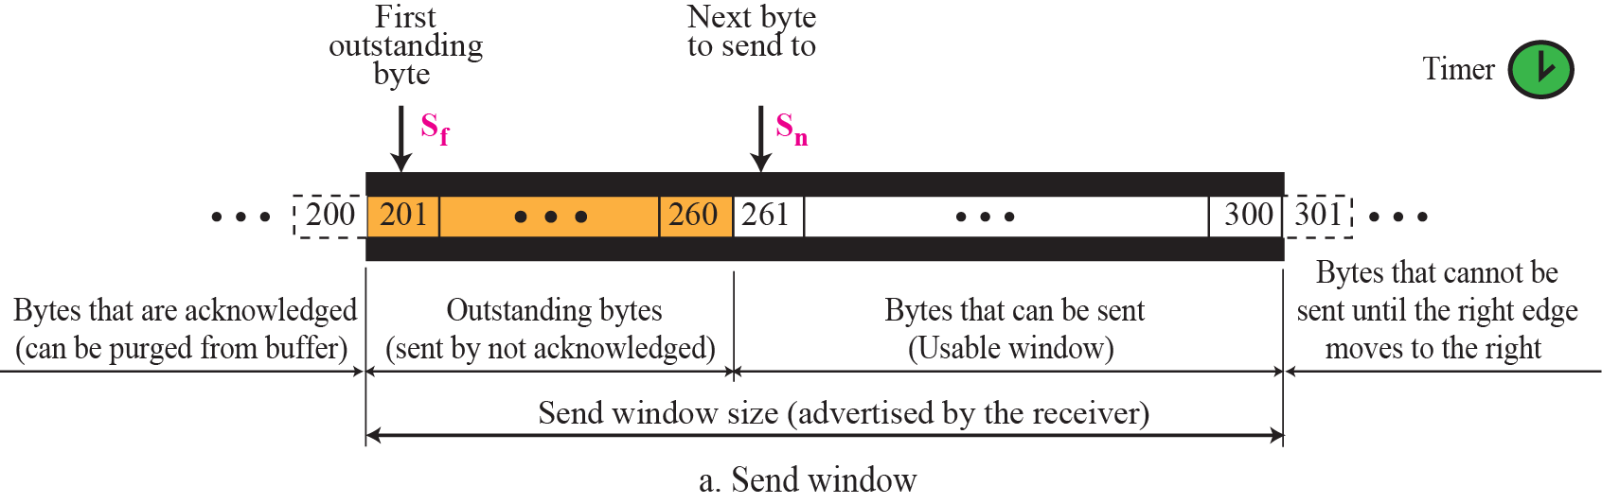
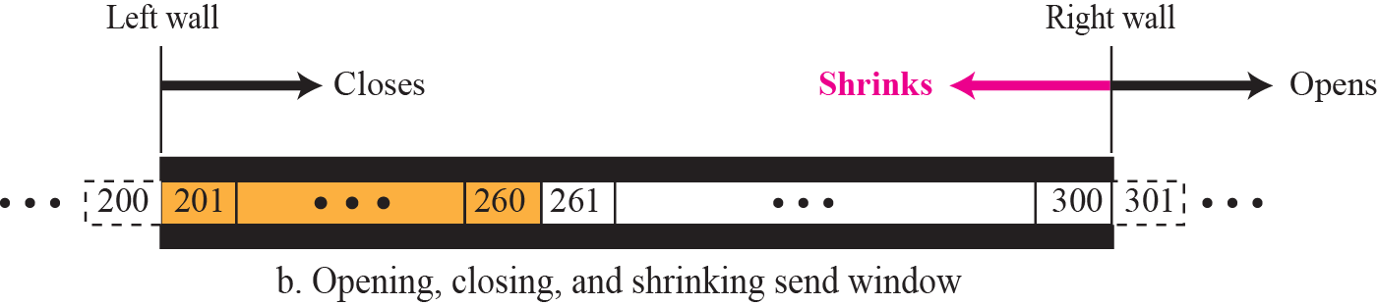
Figure 15.22 Send window in TCP
TCP/IP Protocol Suite
36
Notes:
36

Slide 37
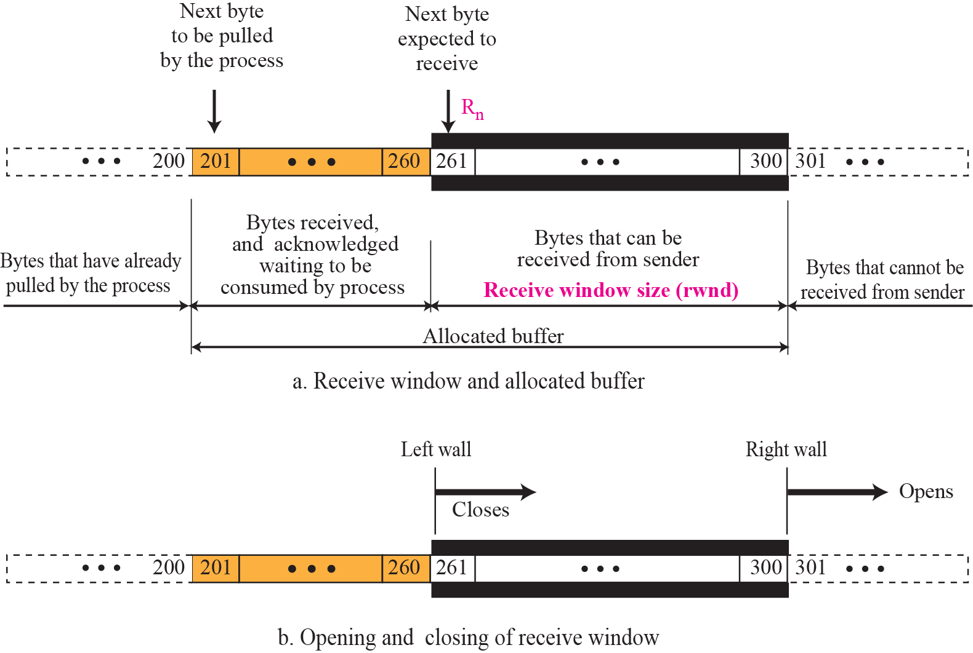
Figure 15.23 Receive window in TCP
TCP/IP Protocol Suite
37
Notes:
37

Slide 38
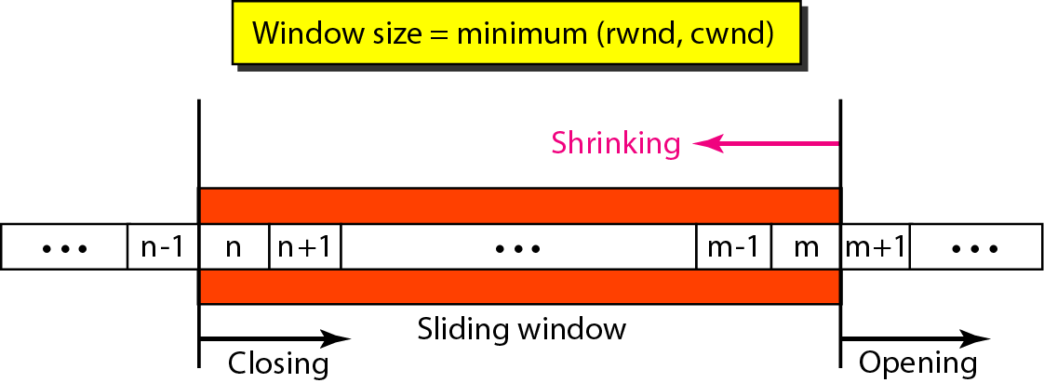
_{Figure 23.22 Sliding window}
_{23.38}
Notes:
₃₈

Slide 39
_{Note}
A sliding window is used to make transmission more efficient as well as
to control the flow of data so that the destination does not become
_{overwhelmed with data.}
TCP sliding windows are byte-oriented.
_{23.39}
Notes:
₃₉

Slide 40
_{Example 23.4}
What is the value of the receiver window (rwnd) for host A if the receiver, host B, has a buffer size of 5000 bytes and 1000 bytes of received and unprocessed data?
_{Solution}
The value of rwnd = 5000 − 1000 = 4000. Host B can receive only 4000 bytes of data before overflowing its buffer. Host B advertises this value in its next segment to A.
_{23.40}
Notes:
₄₀

Slide 41
_{Example 23.5}
What is the size of the window for host A if the value of rwnd is 3000 bytes and the value of cwnd is 3500 bytes?
_{Solution}
The size of the window is the smaller of rwnd and cwnd, which is 3000 bytes.
_{23.41}
Notes:
₄₁

Slide 42
_{Example 23.6}
Figure 23.23 shows an unrealistic example of a sliding window. The sender has sent bytes up to 202. We assume that cwnd is 20 (in reality this value is thousands of bytes). The receiver has sent an acknowledgment number of 200 with an rwnd of 9 bytes (in reality this value is thousands of bytes). The size of the sender window is the minimum of rwnd and cwnd, or 9 bytes. Bytes 200 to 202 are sent, but not acknowledged. Bytes 203 to 208 can be sent without worrying about acknowledgment. Bytes 209 and above cannot be sent.
_{23.42}
Notes:
₄₂

Slide 43
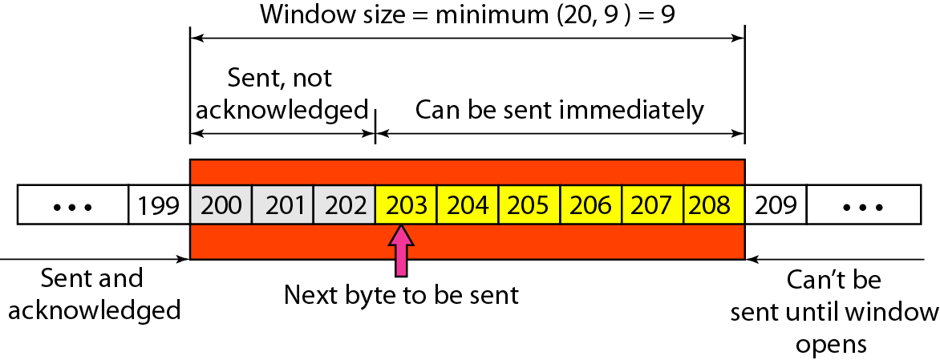
_{Figure 23.23 Example 23.6}
_{23.43}
Notes:
₄₃

Slide 44
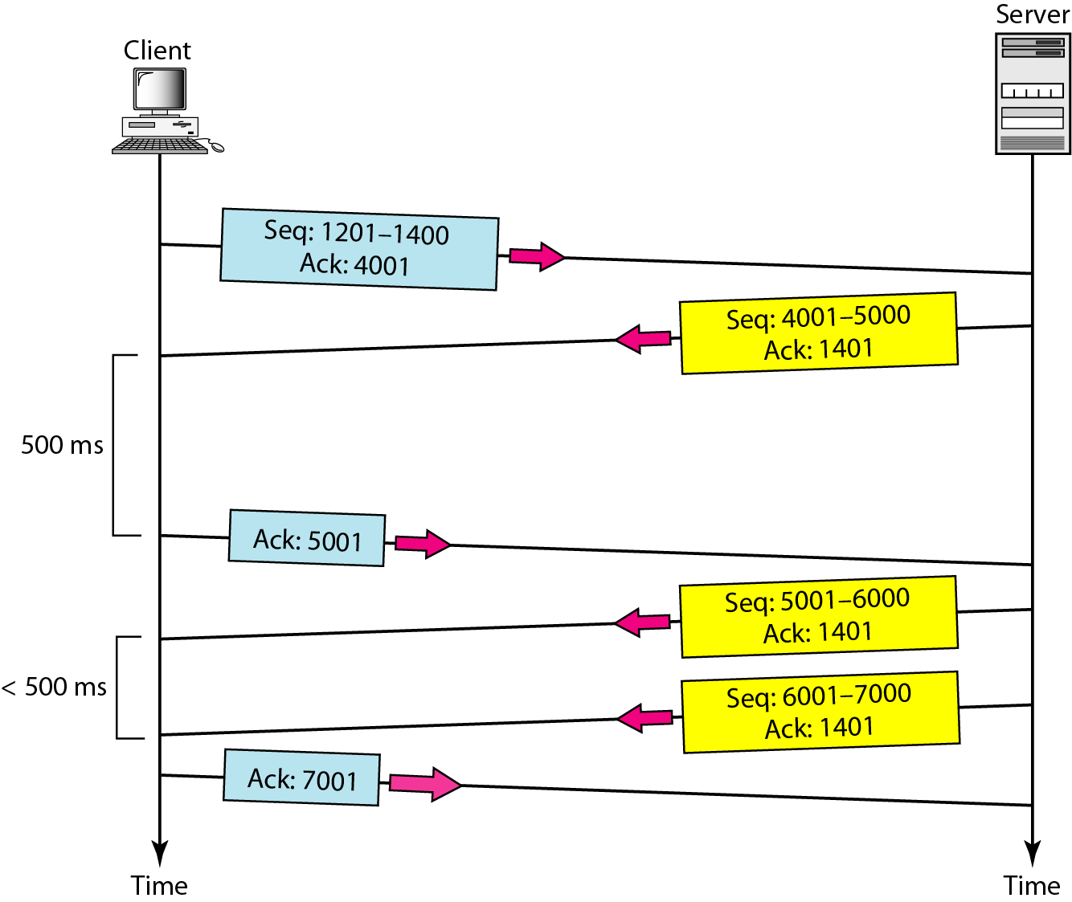
_{Figure 23.24 Normal operation}
_{23.44}
Notes:
₄₄

Slide 45
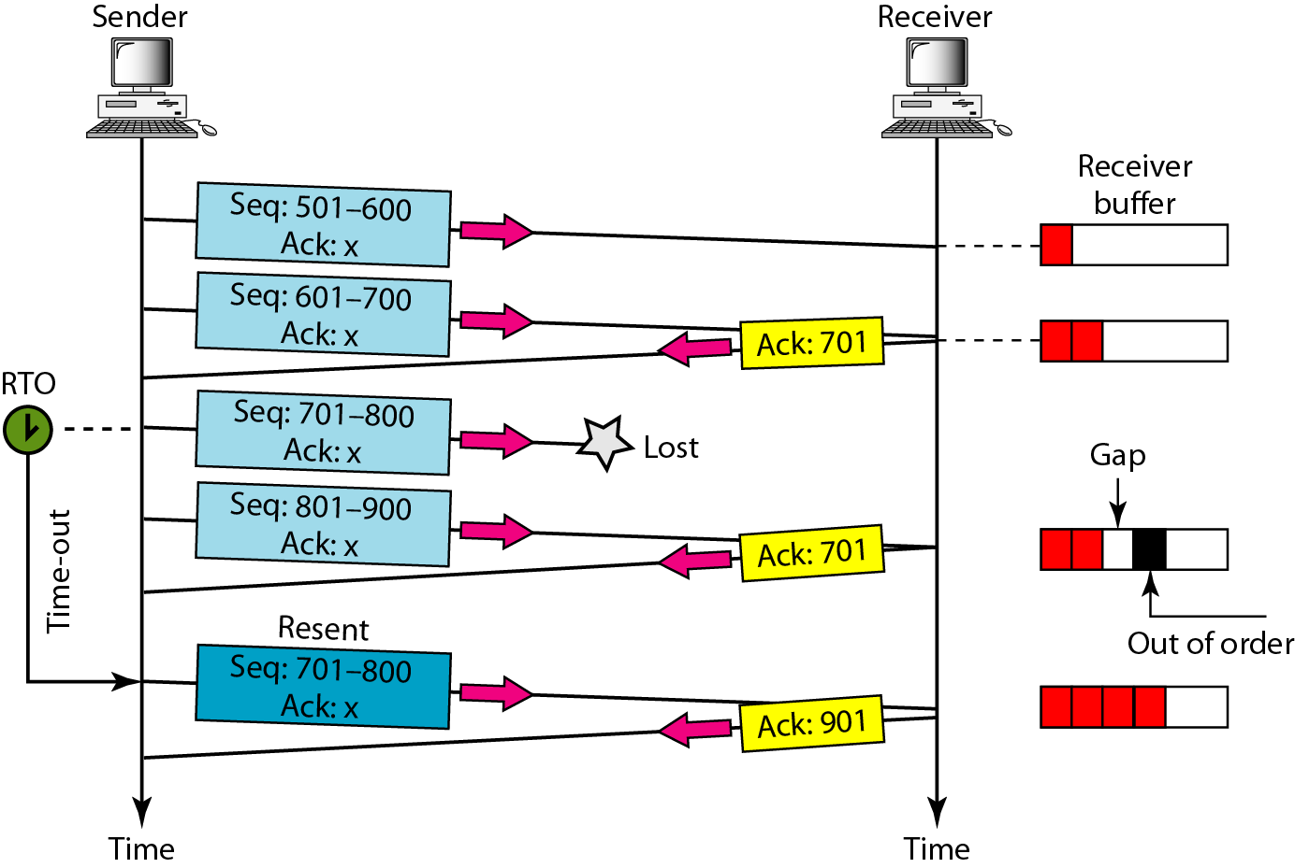
_{Figure 23.25 Lost segment}
_{23.45}
Notes:
₄₅

Slide 46
_{Note}
The receiver TCP delivers only ordered data to the process.
_{23.46}
Notes:
₄₆

Slide 47
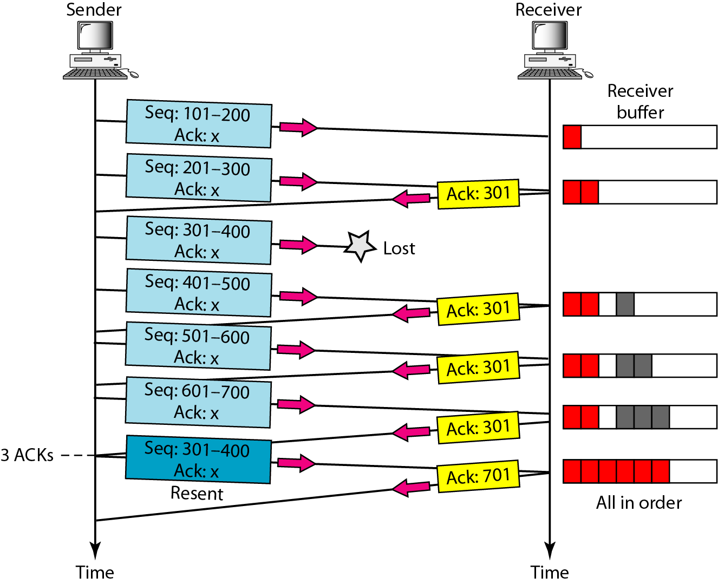
Figure 23.26 Fast retransmission
_{23.47}
Notes:
₄₇

Slide 48
15-9 CONGESTION CONTROL
Congestion control in TCP is based on both open loop and closed-loop mechanisms. TCP uses a congestion window and a congestion policy that avoid congestion and detect and alleviate congestion after it has occurred.
TCP/IP Protocol Suite
48
Notes:
48

Slide 49
Congestion Control in TCP
Slow Start
Additive Increase (Congestion Avoidance)
Multiplicative decrease

Slide 50
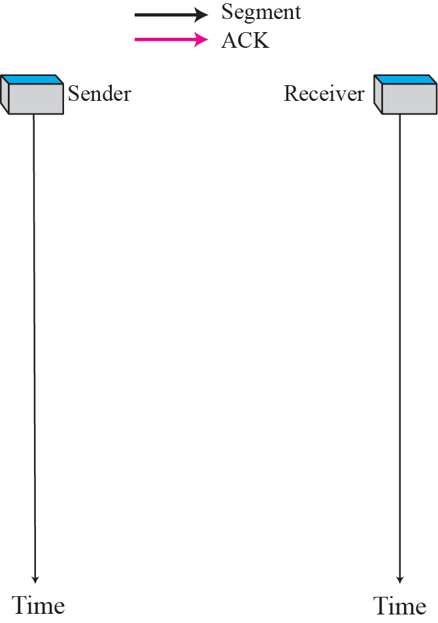

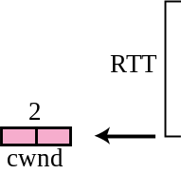


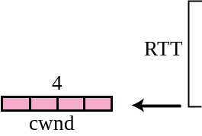
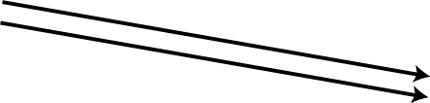

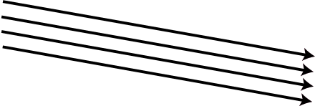
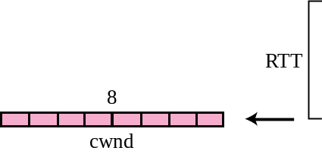
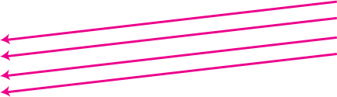
Slow start, exponential increase
TCP/IP Protocol Suite
50
Notes:
50

Slide 51
Note
In the slow start algorithm, the size of the congestion window increases exponentially until it reaches a threshold (ssthresh).
TCP/IP Protocol Suite
51
Notes:
51

Slide 52
What will happen reaches to threshold
ssthresh=window/2
Cwnd=ssthresh

Slide 53
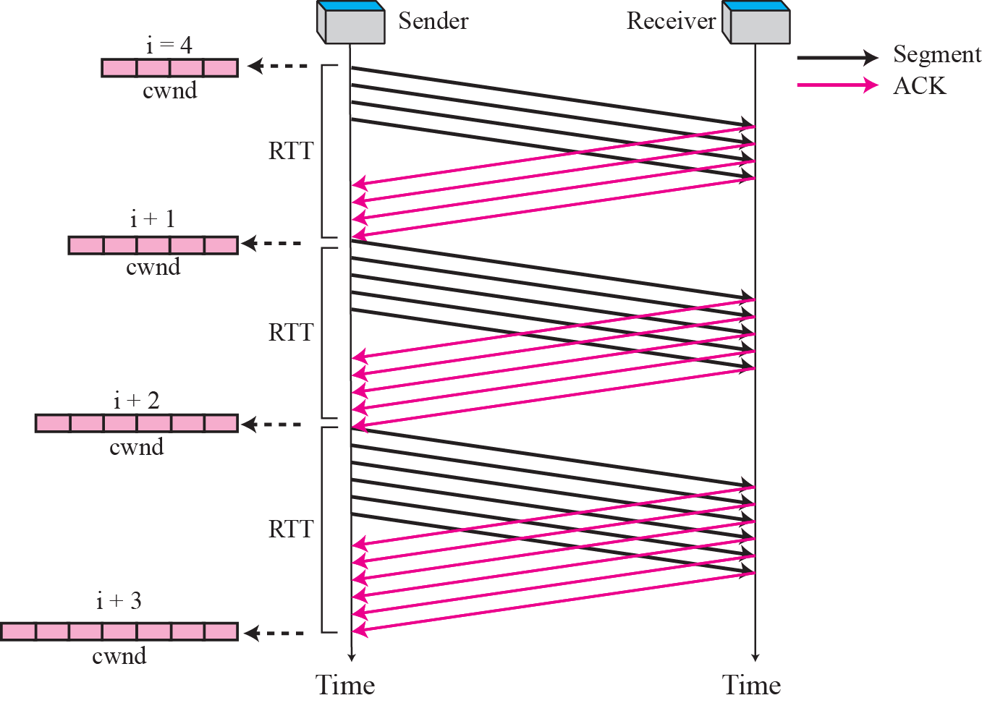
Figure Congestion avoidance, additive increase
TCP/IP Protocol Suite
53
Notes:
53

Slide 54
Note
In the congestion avoidance algorithm the size of the congestion window
increases additively until
congestion is detected.
TCP/IP Protocol Suite
54
Notes:
54

Slide 55
What will happen reaches to threshold
Congestion is detected by timeout
ssthresh=window/2
cwnd=1

Slide 56
Multiplicative Decrease
Congestion is detected by 3 dup Acks
ssthresh=window/2
cwnd=ssthresh

Slide 57
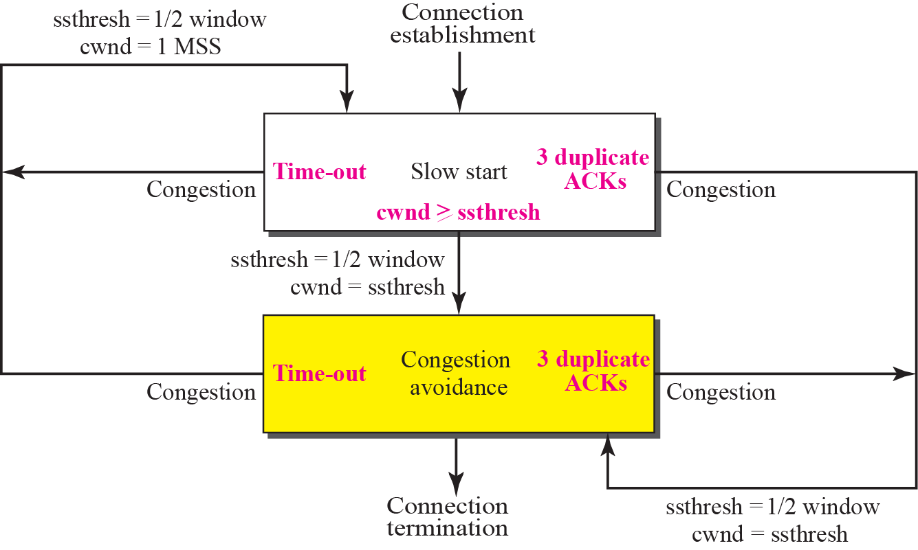
TCP Congestion policy summary
TCP/IP Protocol Suite
57
Notes:
57

Slide 58
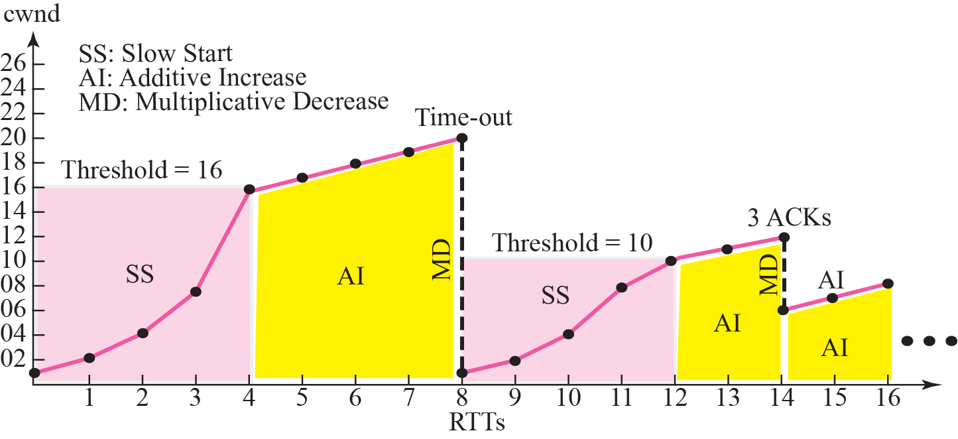
Figure 15.37 Congestion example
TCP/IP Protocol Suite
58
Notes:
58

